Slide 1

Taint Analysis
COMP130159.01
XU, Hui
xuh@fudan.edu.cn
May 16, 2020

Slide 2
1. Concept

Slide 3


Taint Analysis
A well-defined data-flow analysis task.
Purpose: to track the propagations of data.
Rule: the variables whose values are computed based on tainted data are also tainted.
Components:
Sources: Taint Seed
Untrusted input
Sensitive data
Propagation: Taint Policy
Sinks: Taint Checking/Assert
Special calls

Slide 4
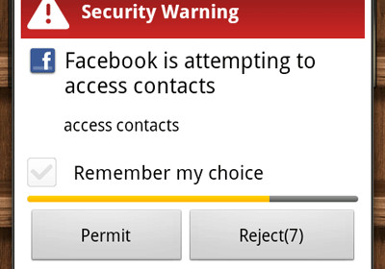
Application: Privacy Leakage Detection
Track the propagation of private data
Source
Read private data
Instructions
Read
Send
Data propagation
Taint Propagation
Sink
Send to server side
Data
Sensitive
Data
Variables

Slide 5
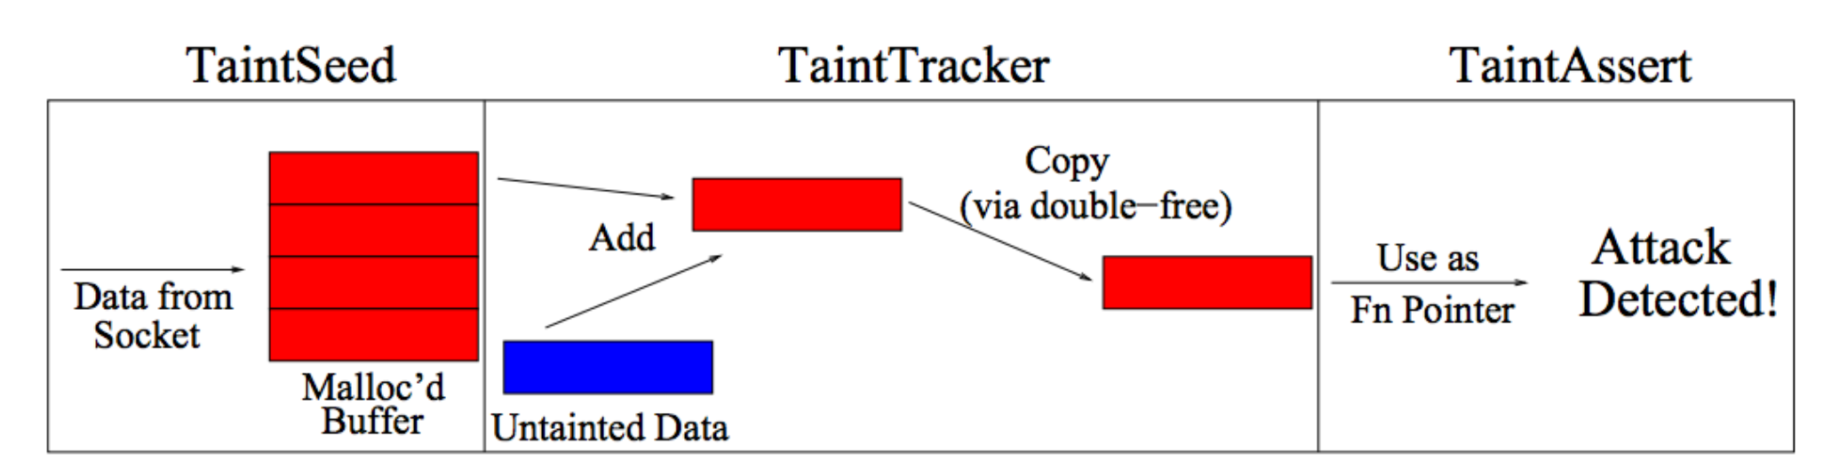
Application: Sanity Check
Check if untrusted data are used dangerously.
James Newsome and Dawn Song, Dynamic Taint Analysis for Automatic Detection,Analysis, and Signature Generation of Exploitson Commodity Software, 2004

Slide 6
Application: Symbolic Execution
Symbolic execution
Track the propagation of Variable
Extract the constraint for executing a particular path.
x = getchar()
(y>0)?
true
false
x ++
y ++
(x == 100)?
true
false
Flag ()
Exit()
Find the value of x for executing flag().

Slide 7
2. Static Taint Analysis

Slide 8
Taint Analysis
OUT
[n] = ( [n] - KILL[n]) ∪ GEN[n]
IN
IN
[n] = [n’]
U
OUT
n’ ∈ (n)
pred.
= U (may) or ∩ (must)
= IN or OUT
= predecessors or successors

Slide 9
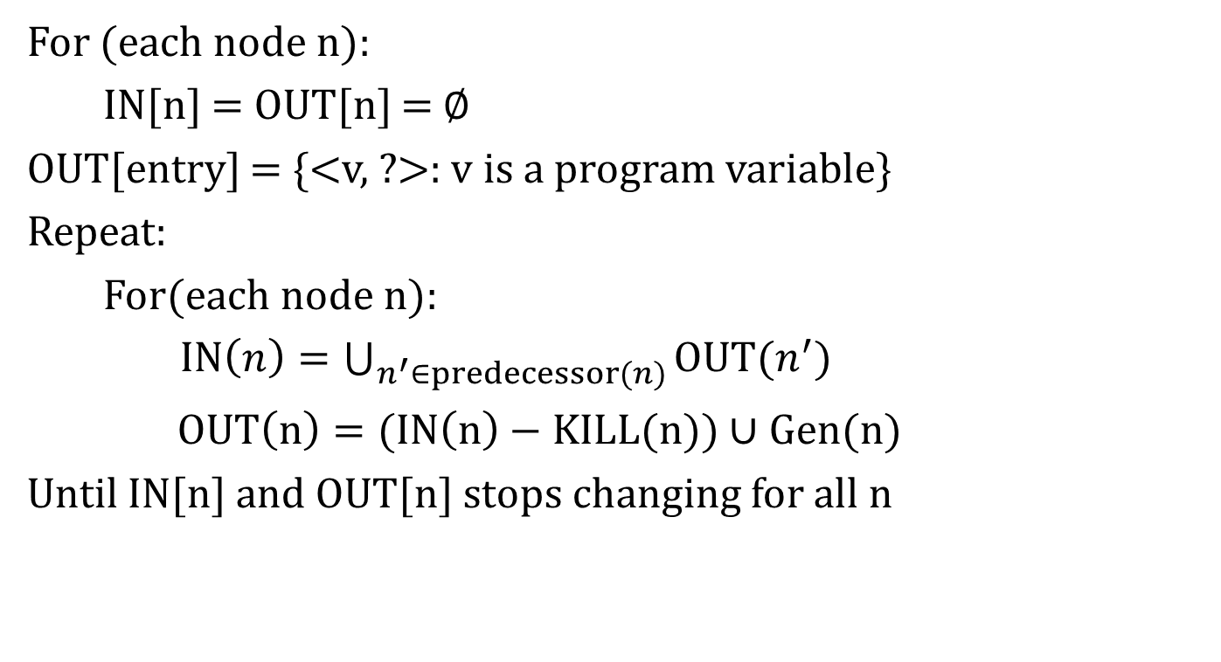
Chaotic Iteration for Taint Analysis
For (each node n):
IN[n] = OUT[n] = $∅$
OUT[entry] = {<v, ?>: v is a program variable}
Repeat:
For(each node n):
$IN\left(n\right)=\bigcup_{n^{′}∈predecessor(n)}{OUT(n^{′})}$
$OUT\left(n\right)=(IN\left(n\right)−KILL(n))∪Gen(n)$
Until IN[n] and OUT[n] stops changing for all n

Slide 10
Define Transfer Function
OUT
[n] = ( [n] - KILL[n]) ∪ GEN[n]
IN
GEN
taint x
x = e, if e is an expression containing tainted data;
KILL
remove x from the tainted data
x = c, if c is a constant.

Slide 11
Exercise
x = source();
y = 0;
while (y < 100)
{
if (x%2 == 0)
y = y + x/2;
else
y = y + 1;
y++;
x--;
}
sink(y);
Entry
x = source()
y = 0
y < 100
(x%2 == 0)?
sink(y)
true
false
y = y + x/2
y = y + 1
y ++
x --

Slide 12
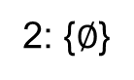
Exercise
IN (round 1)
IN (round 2)
1:
Entry
2: {$∅$}
2:
x = source()
3: {x=T, y=?}
3:
y = 0
6:
4: {x=T, y=UT}
4: {x=T, y=MT}
false
4:
y < 100
sink(y)
true
5: {x=T, y=UT}
5: {x=T, y=MT}
5:
(x%2 == 0)?
6: {x=T, y=UT}
6: {x=T, y=MT}
true
false
7:
y = y + x/2
8:
y = y + 1
7: {x=T, y=UT}
7: {x=T, y=MT}
{x=T, y=T}
{x=T, y=UT}
8: {x=T, y=UT}
8: {x=T, y=MT}
9:
y ++
9: {x=T, y=MT}
10:
x --
10: {x=T, y=MT}

Slide 13
Challenging Issue: Leak or Not?
x = source(0);
y = x;
if(y == 0){
z = 2;
}
else{
z=1;
}
sink(z);
Implicit flows
Tainted data affects the value of another variable indirectly.
Needed for sound analysis.
Under-taint
Over-taint

Slide 14
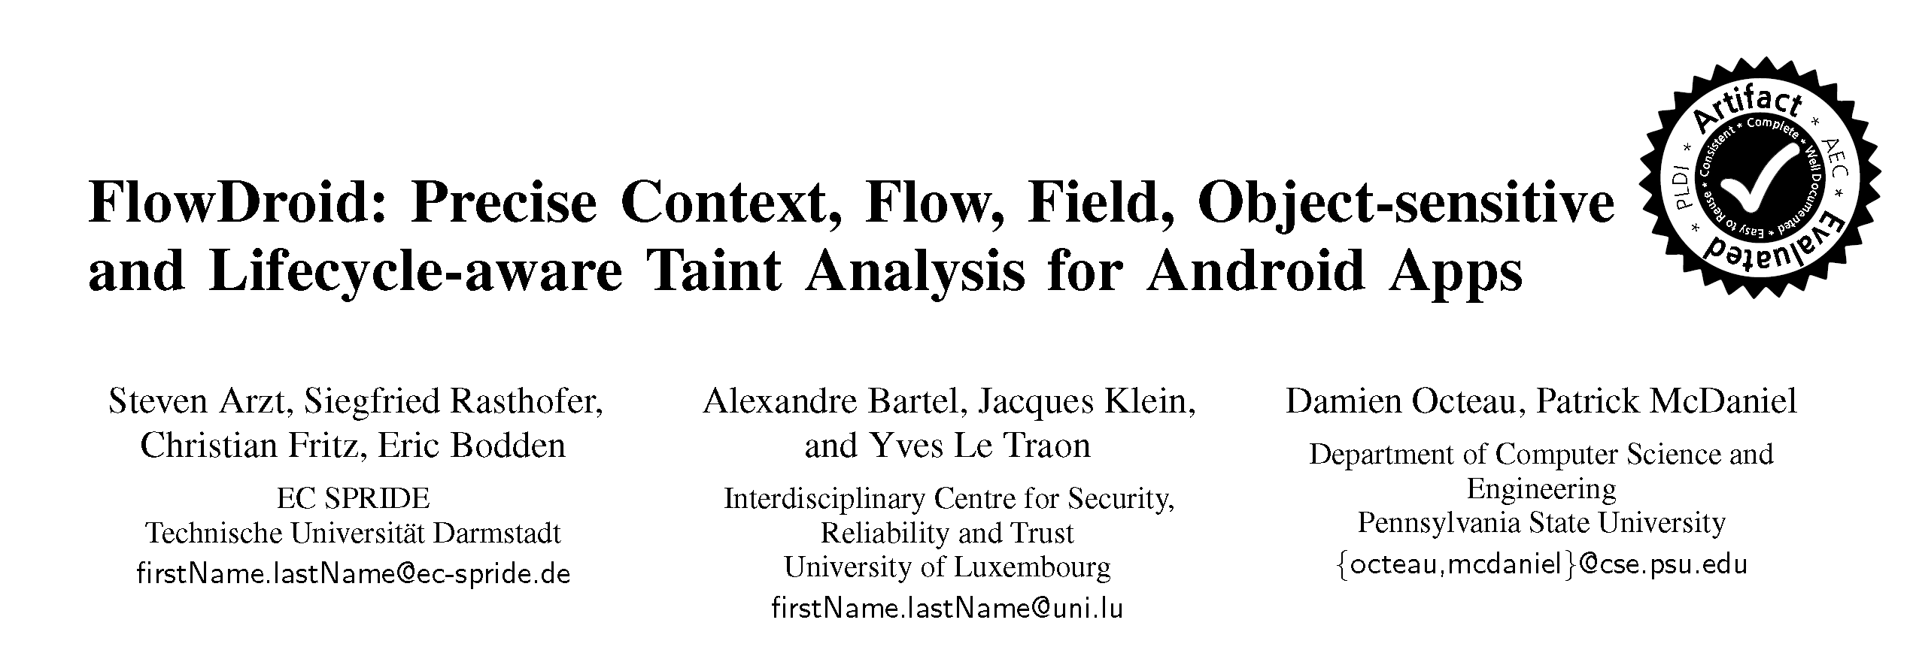
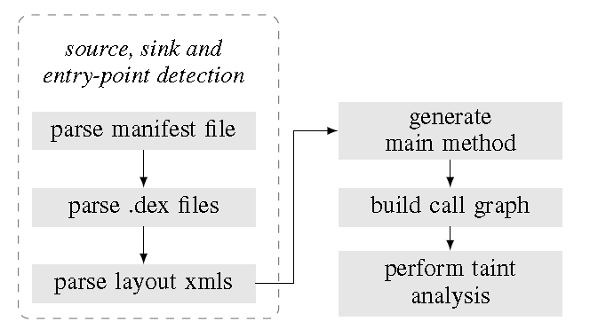
Case Study: FlowDroid
Handle the challenge of Android applications, e.g., callbacks invoked by the Android framework, aliasing.

Slide 15
Sample Android Program
public class LeakageApp extends Activity {
private User user = null ;
protected void onRestart() {
EditText usernameText = (EditText)findViewById(R.id.username);
EditText passwordText = (EditText)findViewById(R.id.pwdString);
String uname = usernameText.toString();
String pwd = passwordText.toString ();
if (!uname.isEmpty() && !pwd.isEmpty())
this.user = new User(uname, pwd);
}
//callback method used in xml files
public void sendMessage(View view){
if(user == null)
return;
Password pwd = user.getpwd();
String pwdString = pwd.getPassword();
String obfPwd = "";
for (char c:pwdString.toCharArray())
obfPwd += c + "_";
String message = "User :" + user.getName() + "| Pwd : " + obfPwd;
SmsManager sms = SmsManager.getDefault();
sms.sendTextMessage("+44 020 7321 0905", null, message, null, null);
}
}
Source
callback
Sink

Slide 16
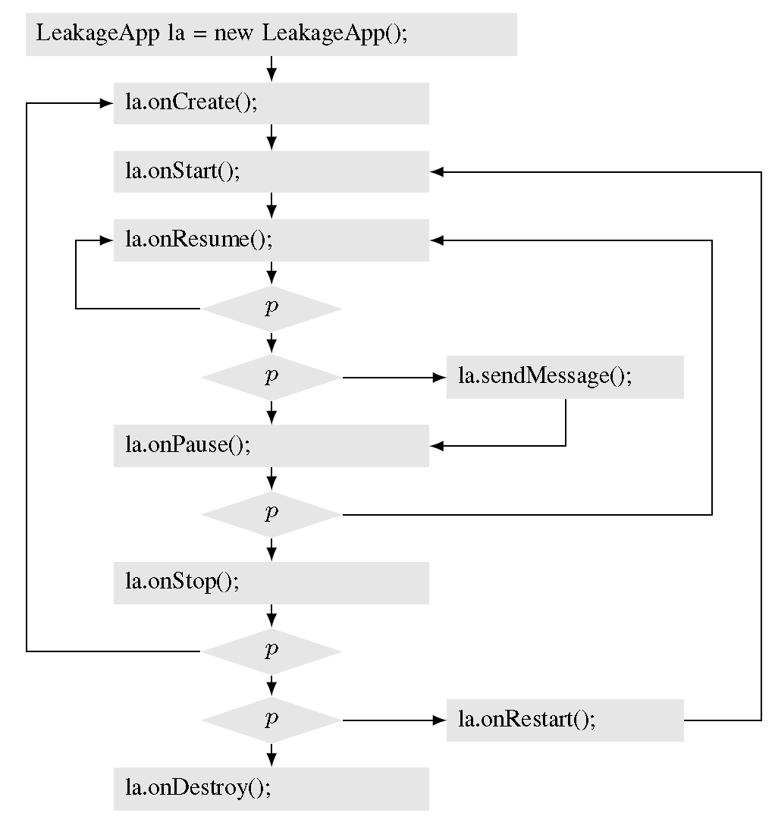
Call Graph for Dummy Main Function
Call Graph:
Node: function/method
Edge: function call
Method calls translate access paths to the callee’s context by replacing actual with formal parameters;
The inverse translation happens at method returns, including the return value if present.

Slide 17
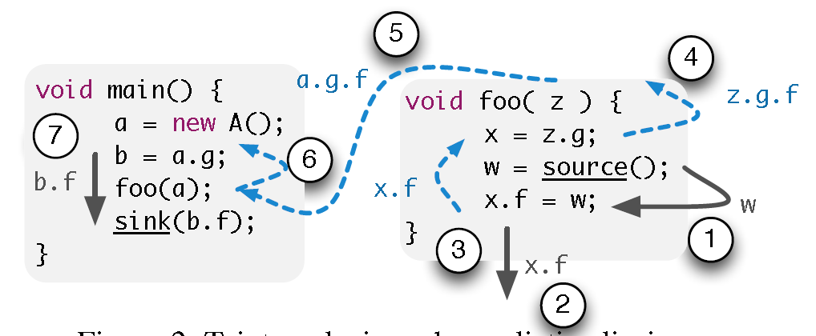
Analysis Approach
Backward alias analysis
Forward taint analysis

Slide 18
Transfer Functions
Access path: Taint the left-hand side if any of the operands on the right-hand side is tainted.
e.g., x.f includes taints x.f.g, x.f.h, x.f.g.h and so on.
Array: Assignments to array elements are treated conservatively by tainting the entire array.
New expression: Assigning a “new”-expression to a variable x erases all taints modeled by access paths rooted at x.

Slide 19
3. Dynamic Taint Analysis

Slide 20

Δ
tainted
untainted
Var
Val
x = get_input( )
y = x + 42
…
goto y
x
7
Input is tainted
τ
TaintSeed:
Var
Tainted?
t = IsUntrusted(src)
Input
x
T
get_input(src)↓ t

Slide 21
Δ
tainted
untainted
Var
Val
x = get_input( )
y = x + 42
…
goto y
x
7
y
49
Data derived from user input is tainted
τ
TaintTracker
Var
Tainted?
t1 = τ[x1] , t2 = τ[x2]
BinOp
x
T
x1 + x2 ↓ t1 v t2
y
T

Slide 22
Δ
tainted
untainted
Var
Val
x = get_input( )
y = x + 42
…
Goto y
x
7
y
49
Policy Violation
Detected
τ
Var
Tainted?
TaintAssert:
Pgoto(ta) = ¬ ta (Must be true to execute)
x
T
y
T
Why? Jump/Return address has been overwritten.

Slide 23
Memory Load
Variables
Memory
Δ
μ
Var
Val
Addr
Val
x
7
7
42
τ
τμ
Var
Tainted?
Addr
Tainted?
x
T
7
F

Slide 24

Problem: Memory Addresses
Var
Val
Δ
x = get_input( )
y = load( x )
…
goto y
x
7
μ
Addr
Val
All values derived from user input are tainted??
7
42
τμ
Addr
Tainted?
7
F

Slide 25
Policy 1:
Taint depends only on the memory cell
Var
Val
Δ
x
7
v = Δ[x] , t = τμ[v]
Load
load(x) ↓ t
Addr
Val
μ
7
42
x = get_input( )
y = load( x )
…
goto y
Jump target could be any untainted memory cell value
Addr
Tainted?
τμ
7
F

Slide 26
Policy 2:
If either the address or the memory cell is tainted, then the value is tainted
v = Δ[x] , t = τμ[v], ta = τ[x]
Load
load(x) ↓ t v ta
Address expression is tainted
Memory
printa
printb
X = get_input( )
y = load(jmp_table + x % 2)
…
goto y
jmp_table
Policy Violation?

Slide 27
General Challenge State-of-the-Art is not perfect for all programs
Undertainting: Policy may miss taint
Overtainting: Policy may wrongly detect taint

Slide 28
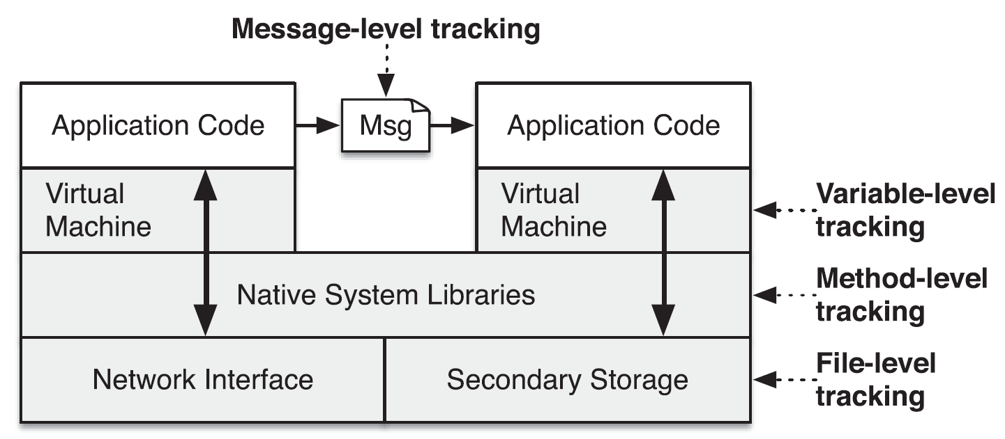
Case Study: TaintDroid
William Enck, et al. “TaintDroid: An Information-Flow Tracking System for Realtime Privacy Monitoring on Smartphones,” OSDI, 2010.
Privacy leakage (misuse) detection for Android applications.
Employ dynamic taint analysis and report leakage during runtime.
Challenge: Track the propagations of private data in Android platform, e.g., Inter-process communication.

Slide 29
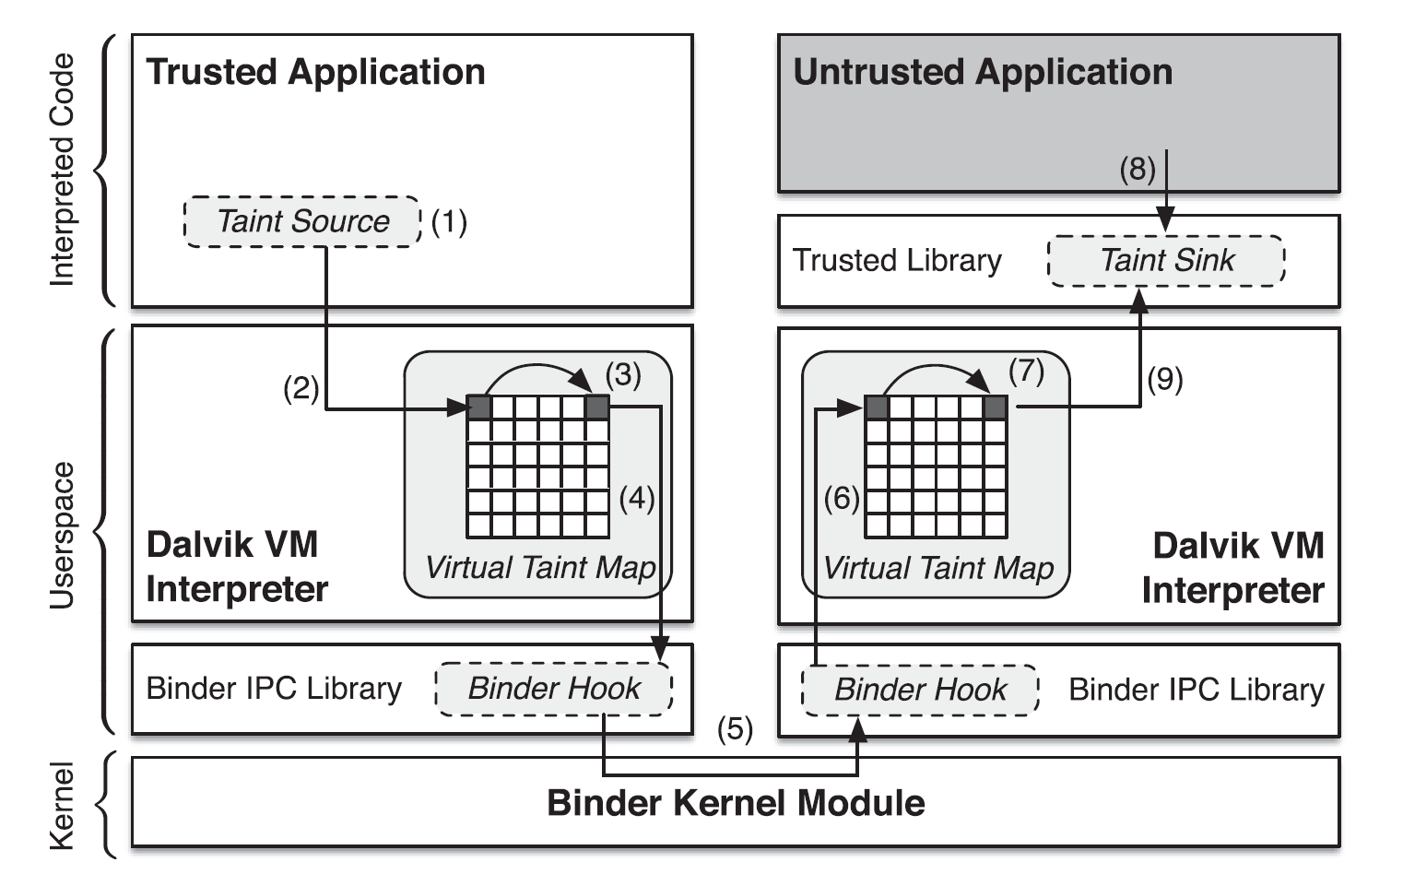
Architecture of TaintDroid
Taint Storage:
Taint Granularity: every bit/byte/word?
Locality: nonadjacent shadow memory, or adjacent?
Taint Propagation:
Granularity

Slide 30
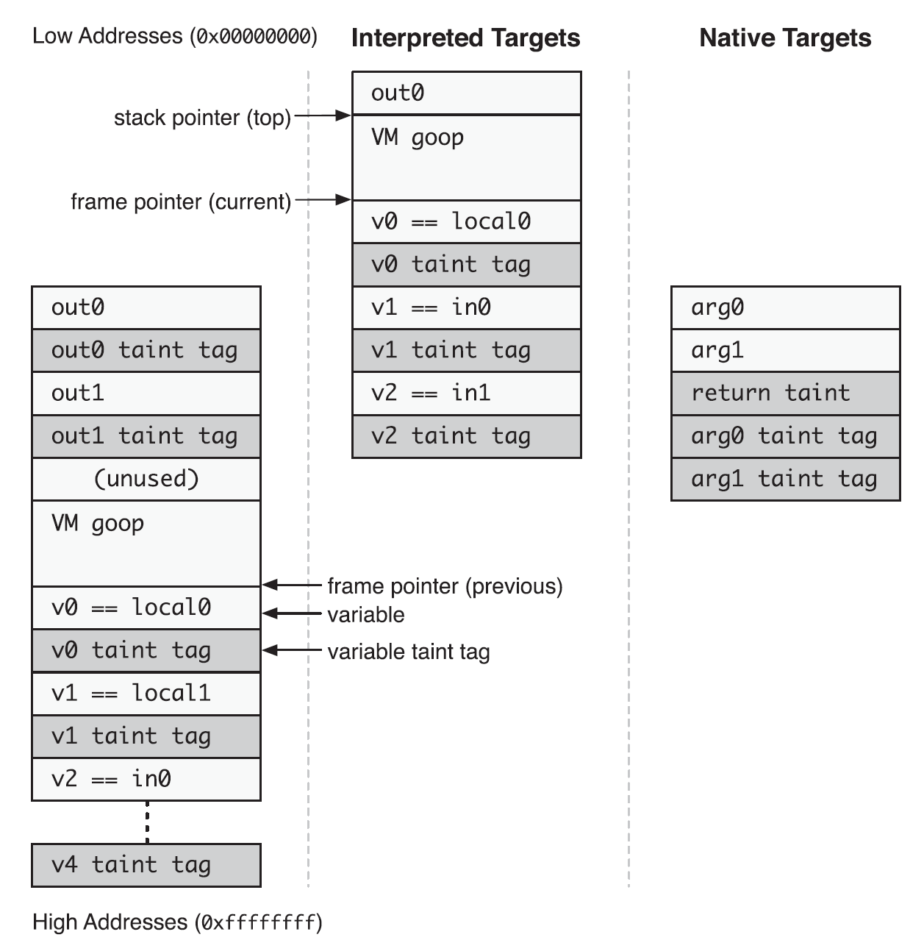
Taint Tag Storage
Method Local variables: an adjacent 32-bit tag for each register.
Each bit corresponds to one type of data, e.g., location, contact, sms.
Arrays: one taint tag per array.
Arguments: same as local variables for interpreted method; different for native functions.

Slide 31
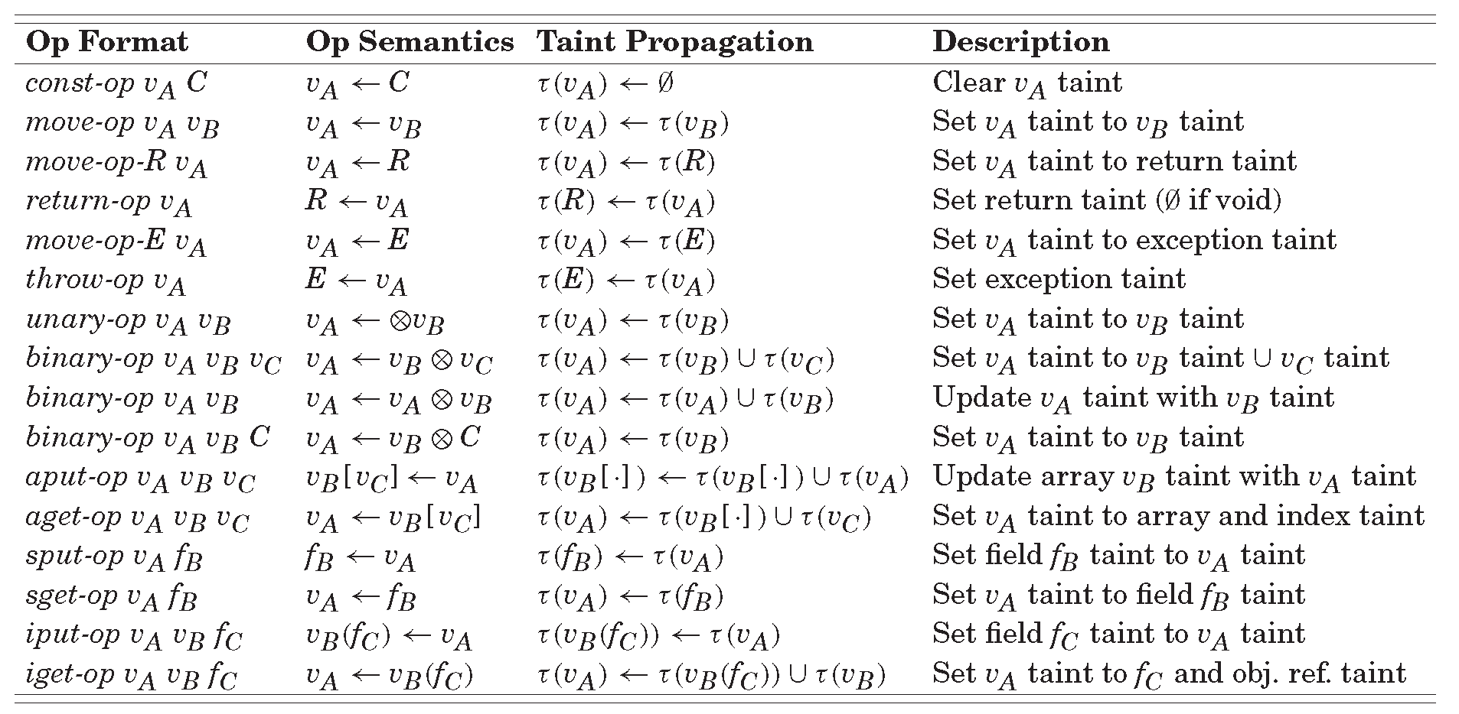
Taint Propagation of Interpreted Code
Variable-level taint tracking

Slide 32
Other Taint Propagations
Taint propagation via
Native code
Internal VM methods: modify the methods.
JNI methods: create a profile for each method, e.g.,
Default strategy: copy the taint tag of arguments to return values
(Binder-based) IPC
Append a taint tag after each message (parcel).
Files
One taint tag per file in its extended attribute.

Slide 33
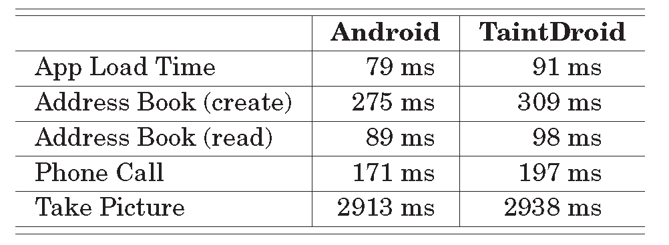
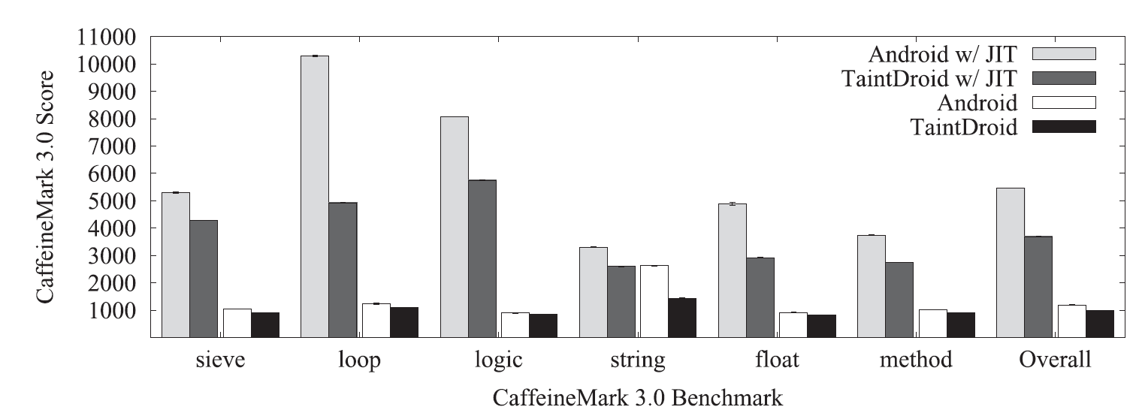
TaintDroid is Not Laggy
Macro benchmark
1%-15% overhead
Microbenchmark
18% overhead
32% overhead with JIT enabled

